Slide 1
Revision Lecture

Slide 2
Topics
Mixing Consoles, Software Mixers
Fundamentals
Delay, Vibrato, Flanging, Chorus
Filters, Tone Controls, Graphic EQ, Parametric EQ, Wah-Wah, Phasers
Compression, Expansion
Distortion, Ring Modulation
Reverb, Doppler, Spatial Audio
Phase Vocoder

Slide 3
Mixing consoles
What is a mixing console?
Electronic device for combining, routing, and modifying audio signals (including level, tone and dynamics)
Analogue or digital signals, depending on type
Modified signals are summed to produce output
Three main functions:
Summing: combining audio signals
Many channels can be summed to stereo (or mono) via mix bus
Processing: modifying audio signal properties
Consoles often have on-board equalisers and sometimes dynamics processors
Routing: grouping, sending and receiving signals
Enable use of external processors and effects
Insert points, auxiliary sends and receives
Notes:
A mixing console, mixing desk, or audio mixer is an electronic device for combining (also called "mixing"), routing, and changing the level, tone, and/or dynamics of audio signals. A mixer can mix analog or digital signals, depending on the type of mixer. The modified signals (voltages or digital samples) are summed to produce the combined output signals.
Mixing consoles are used in many applications, including recording studios, public address systems, sound reinforcement systems, broadcasting, television, and film post-production. An example of a simple application would be to enable the signals that originated from two separate microphones (each being used by vocalists singing a duet, perhaps) to be heard through one set of speakers simultaneously. When used for live performances, the signal produced by the mixer will usually be sent directly to an amplifier, unless that particular mixer is “powered” or it is being connected to powered speakers.
The mixing console offers 3 main functionalities.
Summing – combining the audio signals. Various channels are summed to stereo via the mix bus.
Processing – consoles often have on-board equalisers and sometimes dynamics processors.
Routing – to enable the use of external processors, effects and grouping, consoles offer routing functionality in the form of insert points, auxiliary sends and routing matrices.

Slide 4
Mixing consoles
A mixing console has two main sections:
Channel section
Collection of channels organised in physical strips
Each channel can correspond to an individual track on a multitrack recorder
Most channels support mono input; some support stereo
Some channels will have different types of equalisation, etc.
Master section
Central control over console (global functionality)
Includes master aux sends, effect returns, control room level, ...
Other terms to know
buss, group, effect vs. processor
tracks, mixer strips (software mixers)
Notes:
The mixing console offers 3 main functionalities.
Summing – combining the audio signals. Various channels are summed to stereo via the mix bus.
Processing – consoles often have on-board equalisers and sometimes dynamics processors.
Routing – to enable the use of external processors, effects and grouping, consoles offer routing functionality in the form of insert points, auxiliary sends and routing matrices.
The mixing console has 2 distinct sections.
Channel section- collection of channels organised in physical strips. Each channel corresponds to an individual track on the multitrack recorder. Most channels support mono input, though some consoles will have several types of channels (mono, stereo, channels with different EQs)
Master section – central control over console and global functionality. Includes master aux sends, effect returns, control room level,...

Slide 5
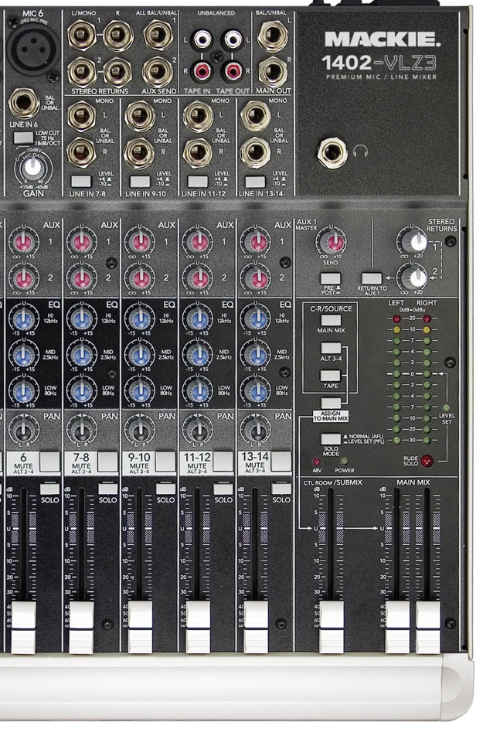
Signal flow in a mixing console
Components
Faders, pan pots & cut switch
Line gains, phase invert & clip indicators
On-board processors
Insertion points (not shown)
Auxiliary sends
FX returns

Slide 6
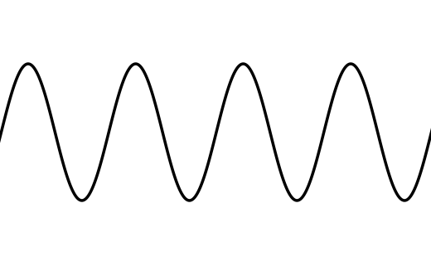
Sampling
Discrete sequences do not have to represent any continuous or physical quantity
But in the audio world, we often work with sampled audio
Sampling = converting continuous time to discrete
Reconstruction = discrete to continuous
T is called the sampling period
1/T is the sampling frequency or sample rate (fs)

Slide 7
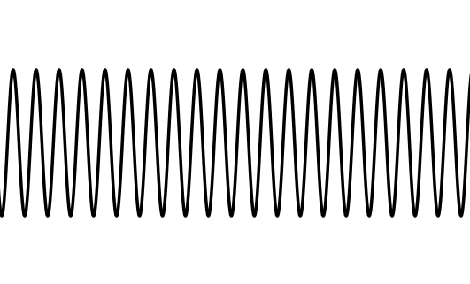
Sampling 2
Reconstruction is harder than sampling
Sampling inherently loses information
How do we distinguish between these two cases?
Need a band-limited input signal
Limited frequency range
Nyquist Sampling Theorem
Need to sample a signal at twice its highest frequency to be able to uniquely reconstruct it
This frequency is called the Nyquist frequency

Slide 8

Properties of digital systems
x[n]
f
y[n] = f(x[n])
Linearity:
Time invariance:
Linear, Time-Invariant (LTI) systems are a common useful case
Stability:
x[n] bounded y[n] bounded
Causality:
x[n] = 0 for n < 0 y[n] = 0 for n < 0
f doesn’t depend on any future sample (i.e. greater n)
Memorylessness:
y[n] only depends on the current value of x[n]
Notes:
Useful properties to know. Which DAFX satisfy or break these properties?

Slide 9
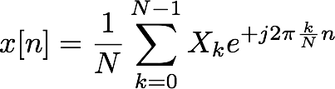
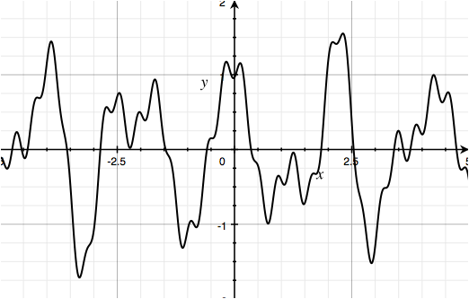
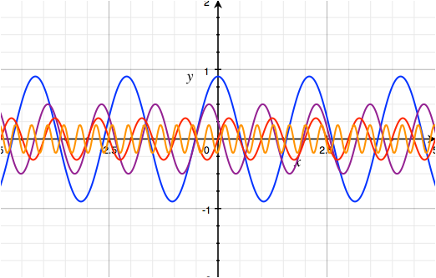
Time and frequency domain
Any x[n] can be represented as a sum of sinusoids...
So let’s do that then!
The second version is called the frequency domain representation of x
* or at least discrete samples of the frequency domain...
What frequencies are present, with what amplitude and what phase? From this we can exactly determine x[n].
Things to know:
z-transform, relationship to frequency response
Converting between time & z-domains

Slide 10
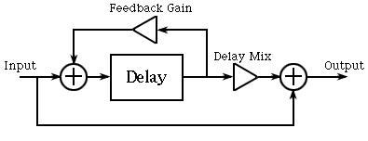



Delay (with feedback)
Most delays have feedback control (regeneration)
Take the delay output, send it back to the input
To derive y[n] in terms of x[n]:
f
x[n]
d[n]
y[n]
a
D
Notes:
Just having a single echo effect is rather limiting, so most delays also have a feedback control (sometimes called regeneration) which takes the output of the delay, and sends it back to the input, as shown in Figure. Now you have the ability to repeat the sound over and over, and it becomes quieter each time it plays back (assuming that the feedback gain is less than one. Most delay devices restrict it to be less than one for stability). With the feedback, the sound is theoretically repeated forever (at least until you turn the unit off), but after some point, it will become so quiet that it will be below the ambient noise in the system and inaudible.
Figure 2: Diagram of the basic delay unit with feedback.

Slide 11
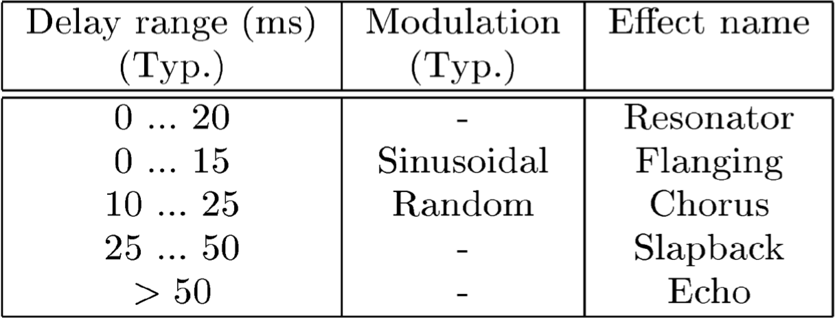
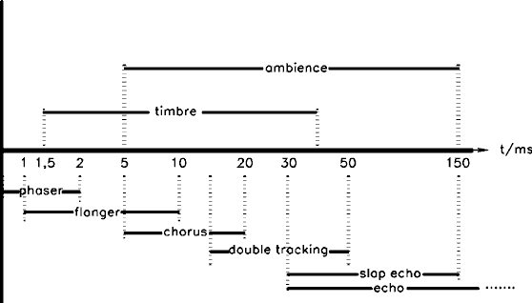
Delay 2
Other things to know:
How to convert between block diagram & transfer function
Variations: multi-tap, ping-pong, etc.
Fractional delay
Implementation on a circular buffer (basics, not code)
Notes:
From http://www9.dw-world.de/rtc/infotheque/sound_processors/soundprocessors.html and DAFX Textbook

Slide 12

Flanging
Feedforward comb filter
Input-output relation:
x[n] - input signal
y[n] - output signal
g - depth of flanging effect
M(n) - length of delay line at sample n
M(n) must vary smoothly over time
Interpolated (fractional) delay line allows noninteger M
How are chorus and vibrato different?
Also know:
Variations (feedback, stereo, etc.)
Parameters
Notes:
Flanging is modeled quite accurately as a feedforward comb filter, in which the delay M is varied over time. Figure depicts such a model. The input-output relation for a basic flanger can be written as
y(n)=x(n)+gx[n- M(n)]
where x(n) is the input signal amplitude at time n=0,1,2…, y(n), is the output at time n, g is the ``depth'' of the flanging effect, and M(n) is the length of the delay-line at time n. Since M(n) must vary smoothly over time, it is clearly necessary to use an interpolated delay line to provide non-integer values of M in a smooth fashion.

Slide 13
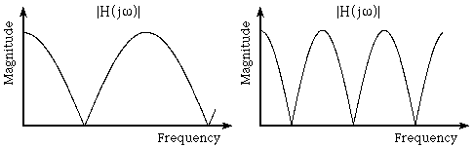
Flanger frequency response
Delay & add has filtering effect on signal
Creates series of notches in frequency response
Eliminates a periodically spaced set of frequencies
Other frequencies passed with amplitude change
Comb filter (notches resemble teeth on comb)
Frequency response for two flangers with depth 1.
Which one has the smaller delay, and why?
Notes:
Instead of creating an echo, the delay has a filtering effect on the signal, and this effect creates a series of notches in the frequency response, as shown in Figure 2. Points at which the frequency response goes to zero means that sounds of that frequency are eliminated, while other frequencies are passed with some amplitude change. This frequency response is sometimes called a comb filter, as its notches resemble the teeth on a comb.

Slide 14
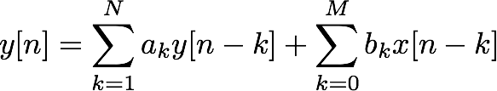
IIR filters (also know FIR)
More general form:
Output depends on last M inputs and N outputs
Infinite Impulse Response (IIR)
Unless all ak = 0
Often N = M in practice, but this is not required
max(N,M) called order of filter
Properties of IIR filters
Linear
Time-invariant
Stability depends on coefficients ak
Most equalisers use IIR filters

Slide 15
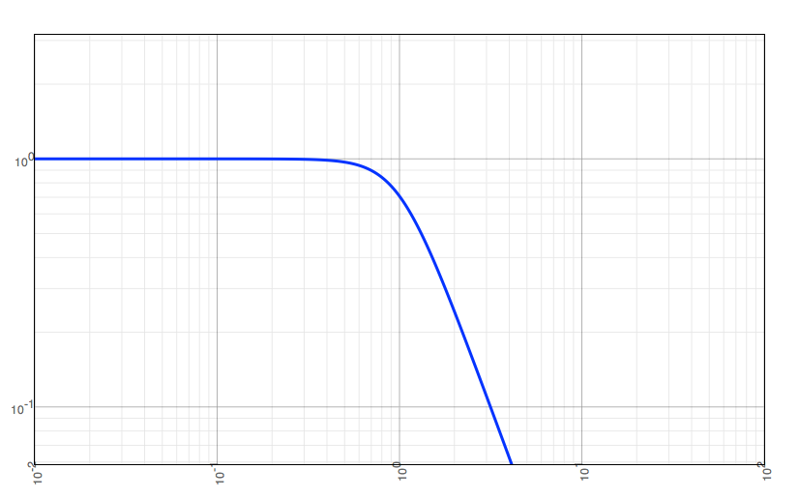
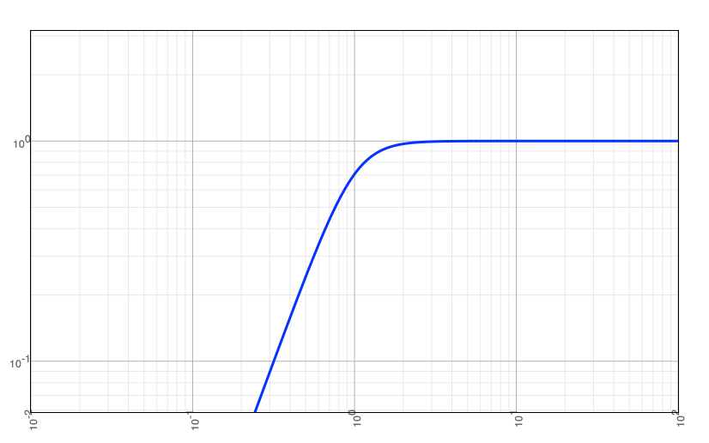
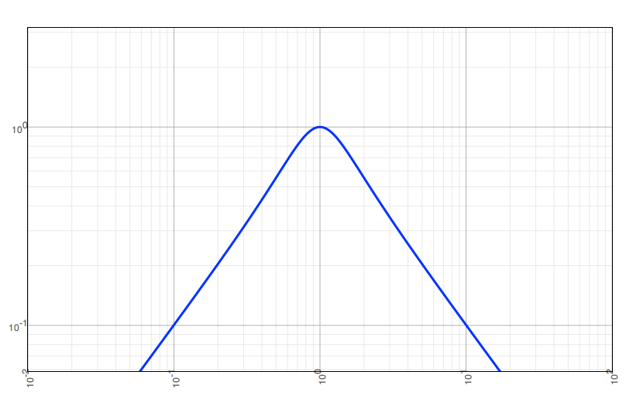
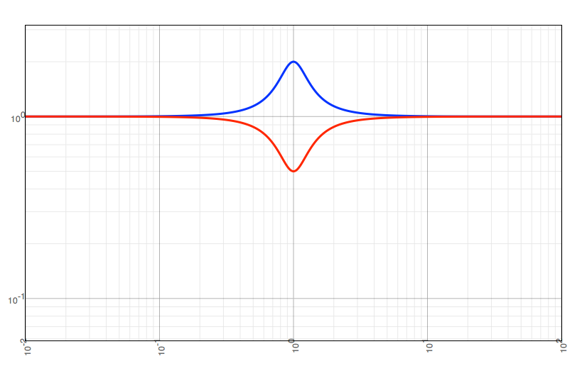
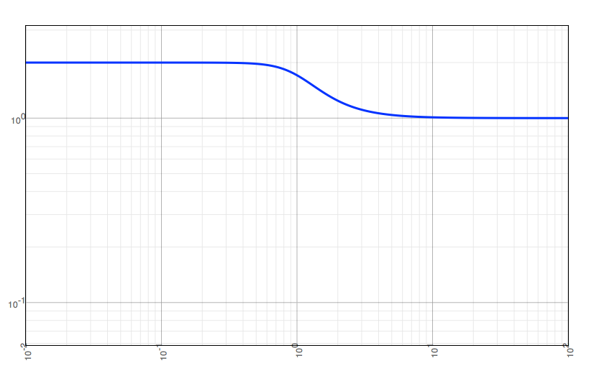
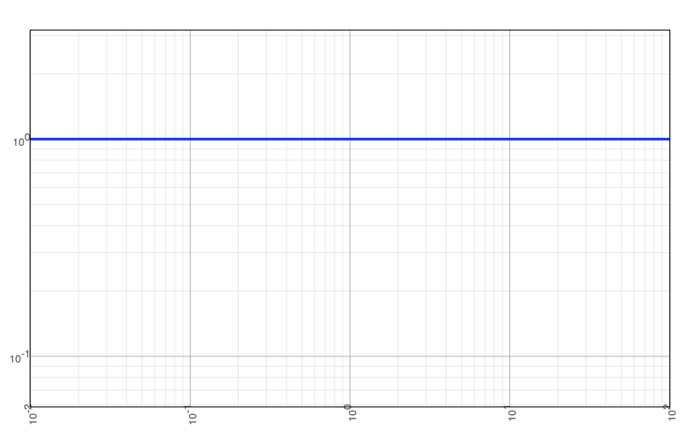
Types of filters
Types we frequently encounter in audio systems:
Lowpass
Highpass
Bandpass
Peaking / Notch
Shelving
Allpass

Slide 16

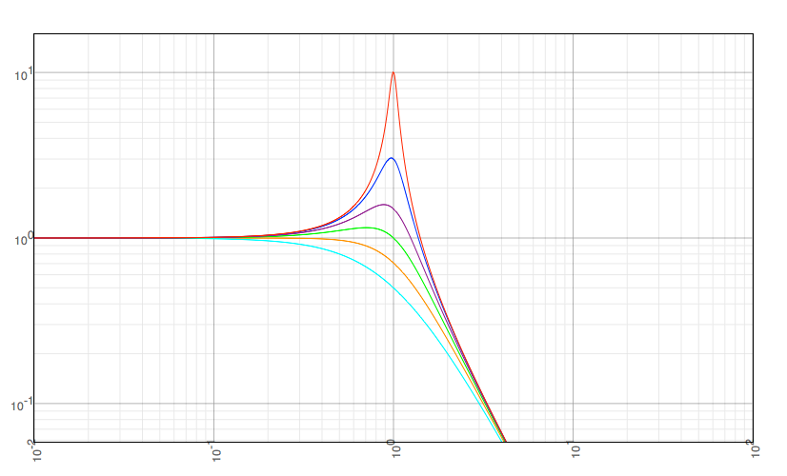
Filter Q
Filters can be described “quality factor” Q
Selectivity (bandwidth) relative to centre frequency
Second order
lowpass filters (all)
Q = 0.5
Q = 0.71
Q = 1
Q = 1.5
Q = 3
Q = 10

Slide 17
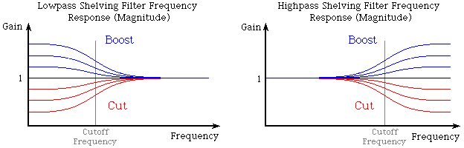
Tone controls
Most common equalisation is the tone control
Controls: bass and treble
Adjust sound to suit your taste, or the room
Bass control = lowpass shelving filter
Treble control = highpass shelving filter
Control centred = unity gain = flat response
Notes:
The most common equalisation system is probably the tone controls that can be found on most stereo systems. They provide a quick and easy way to adjust the sound to suit your tastes and partially compensate for the room. You will often find the controls labeled 'bass' and 'treble.' Each of those knobs controls a special type of filter called a shelving filter, or more precisely, a lowpass shelving filter and a highpass shelving filter respectively. The frequency responses for these two filters are shown in Figure. (Most filters have a gain that changes with frequency. The plots are of the frequency response magnitude, which shows you the gain at each frequency component. A gain greater than one will boost the signal, and if the gain is less than one, it cuts the sound.)

Slide 18
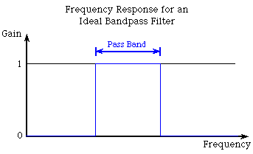
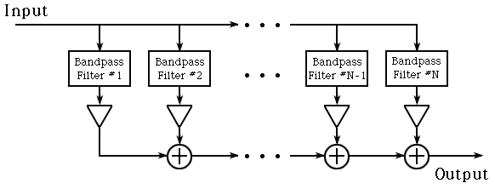
Graphic EQ (parallel implementation)
Consider as bank of bandpass filters
Completely isolate individual frequency bands
Real bandpass filters have some ripple in passband and don’t have a perfectly sharp cutoff
Arrange filters in parallel
Each has the same input
Outputs are summed (mixed) after band gains adjusted
Also know: how band frequencies are chosen
Notes:
The actual implementation of a graphic equaliser is different than the common tone controls. The bass and treble tone knobs on your stereo boost or attenuate only certain frequency bands while letting everything thing else pass unaffected, so we can chain them in series. A graphic equaliser uses a set of bandpass filters that are designed to completely isolate certain frequency bands. The top figure shows the frequency response for an ideal bandpass filter.
In order to have control over the total audio spectrum, the filters need to be arranged in parallel, as shown in the bottom figure. Each filter in the graphic equaliser has the same input. Their job is to only allow a small band of frequencies through.

Slide 19
Graphic EQ (series implementation)
Consider cascade of peaking or shelving filters
Add a boost or notch to a specific frequency band
Top and bottom bands may be shelving filters which extend to edge of spectrum
Each filter has a gain of 1 outside the band
Arrange filters in series
Each takes its input from the previous filter
Boost/Cut
Level
Boost/Cut
Level
Boost/Cut
Level
Boost/Cut
Level
Boost/Cut
Level
Peak/Notch
Peak/Notch
Peak/Notch
...
Peak/Notch
Peak/Notch
x[n]
y[n]
50Hz
100Hz
200Hz
6.4kHz
12.8kHz
Gain of 1 (0dB)
Shelving LP
Shelving HP
50Hz
12.8kHz
(variation)
(variation)

Slide 20
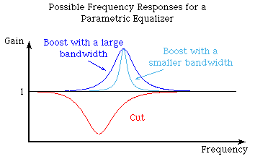
Parametric EQ plots
Controls: centre frequency, gain, bandwidth
These plots for peaking filters (not shelving)

Slide 21
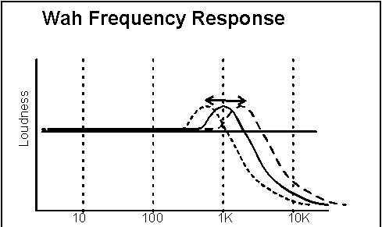
Wah-wah
Resonant (bandpass or peaking) filter
Variable centre frequency
Small bandwidth (i.e. high Q)
Standard wah-wah
Centre frequency controlled by pedal (manual control)
Auto-wah (2 effects)
Centre frequency controlled by LFO
Frequency of LFO usually around 1-2 Hz
OR, could depend on envelope of input signal
Tremolo-wah: also amplitude variations
Centre frequency can vary from near 0 to fs/2
In practice, varies across the midrange frequencies only
Notes:
A wah-way effect is created by a bandpass filter with variable center frequency and small bandwidth. The center frequency is controlled by a low frequency oscillator (LFO) with frequency around 1-2 Hz, or can be controlled by an external control input device such as a foot pedal, mouse or slider. The center frequency varies from near 0 to a frequency less than half the sampling rate. The output of the bandpass filter is added to the direct (input) signal.
There are three types of wah wah effects.
For the standard wah-wah, as used commonly on guitar pedals: the player controls the effect via a foot pedal manually, that is, the center frequency is moved up or down in frequency by moving a pedal.
The auto-wah adjusts the effect automatically according to the amplitude of the signal from the guitar (auto-wah, or envelope follower). Here, the center frequency is determined by the loudness of the input signal, making a moving resonance on every note
An Envelope follower is the name for a device used in musical electronic environments that detects the amplitude variation during time of an incoming sound and produces a control signal that resembles it. Here it is used to modify certain parameters of other controllable devices (Filters, Wave shapers etc.) in relation with the incoming signal's amplitude.
If the variation of the center frequency is mixed with low-frequency amplitude, it produces a tremolo, and produces the tremolo-wah effect. (A rapid repetition of a single tone).
For a Tremolo-wah filter, the gain factor must be varied independently to yield a linear time-varying filter.
Tremolo function is one of the examples to make a linear time varying filter, it can be written as a time-varying gain,
For example, y(n)=x(n)g(n), where g(n)=1+cos(ωt)
The calculation of the time-variant gain factor g(n) is usually performed with a logarithmic level representation, because the human sensitivity of loudness follows a logarithmic relation.

Slide 22


Phasing
Notches implemented indirectly by allpass filters
Allpass filter passes all frequencies equally
No amplification or attenuation:
It’s all about the phase
Add filtered output to original
Amount of filtered output controlled by depth or mix control
Where do the notches come from?
Also know:
Parameters; variations (stereo, feedback, etc.)
Differences between phaser and flanger
Notes:
The notches needed for phase shifting (or simply called phasing) are most often implemented using a special group of filters called allpass filters. As the name implies, the allpass filter passes all frequencies - that is it allows all frequencies to appear in the output with no attenuation or amplification. So if you were to put any sine wave into the allpass filter, you would see a sine wave at the output, with the same amplitude it was at the input. To complete the phase shifter, we just add the filter output to the input signal, as in the Figure. The amount of the filtered signal that appears in the output is set by the depth (also called the 'mix' or 'level') control.
Well that's interesting, but if the filter passes all frequencies equally, how does it alter the sound, and where do the notches come from? Well there's one other characteristic of the filter we haven't mentioned yet, and that is the filter's phase response.

Slide 23
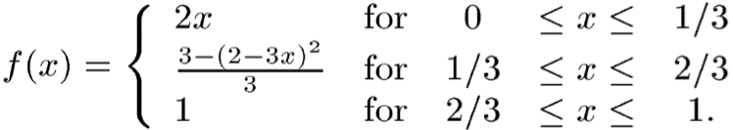
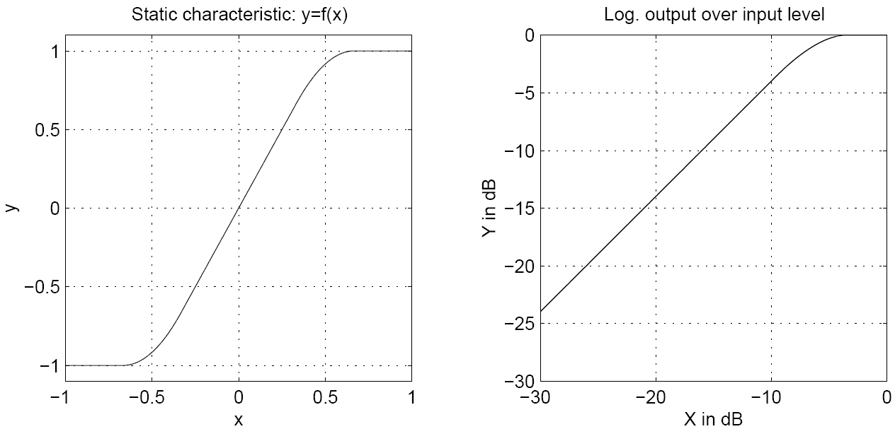
Distortion (soft clipping variations)
Most analogue systems have smooth transition from linear to non-linear
Rounded tops of waveforms known as soft clipping
Notice: G = 2
Notes:
Symmetrical soft clipping. For overdrive simulations a symmetrical soft clipping of the input values has to be performed. One possible approach for a soft saturation nonlinearity [Sch80] is given by the equation. The static input to output relation is shown in the figure. Up to the threshold of 1/3 the input is multiplied by two and the characteristic curve is in its linear region. Between input values of 1/3 up to 2/3, the characteristic curve produces a soft compression described by the middle term of equation. Above input values of 2/3 the output value is set to one.

Slide 24
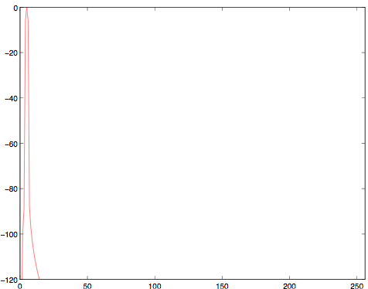
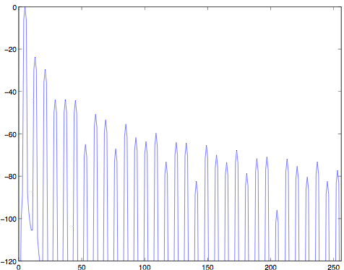
Distortion in the frequency domain
Distortion is a nonlinear effect (why?)
Non-linearity introduces new frequency components that weren’t present in the original signal
Fourier Transform: Sine input
Fourier Transform: Hard clipping (G = 5)
Magnitude (dB)
Magnitude (dB)
Bin #
Bin #

Slide 25

Intermodulation distortion
The bane of fuzzbox technology
Trig. identity:
Sum and difference frequencies are products of intermodulation between inputs
When we apply non-linear distortion, intermodulation products will show up in the spectrum
If two tones are harmonically-related
Intermodulation products will be harmonically-related as well
If two tones are not harmonically-related
Intermodulation produces will be harsh and dissonant
Exact guitar tuning is especially important when using distortion!
Also know:
Aliasing (and addressing it); hard clipping; (a)symmetry
Rectification, other variations
Notes:
Intermodulation distortion is the bane of fuzzbox technology. If you take any two pure sine waves and intermodulate them, you get not only the two sine waves, but two other frequencies - the sum of the two originals, and the difference. If we had A-440 and A-880, and intermodulated them, we'd get 440, 880, 440 again from the difference, and 1320, which is three times A-440. This would actually sound pretty good.
The bad part about this is that we picked the best possible example. However, if we take A-440 and the note an octave and a third up, 1467 Hz, we get the original notes plus 1026 Hz, and 1907 Hz. These frequencies are NOT related to the original note and sound harsh or out of tune. We're also talking about sine waves. Real world signals always have some harmonics, and we get the sums and difference of all the harmonics, too. Very unmusical.
So the name of the game is to produce harmonic distortion, which makes musically good sounding notes and to minimize intermodulation distortion, which makes un-musical squarks and harsh buzzes. Unfortunately, no matter how hard we try, we can never get all harmonic distortion and no intermodulation distortion. But we can pick between distortion mechanisms to use the better ones and avoid the worse ones.

Slide 26
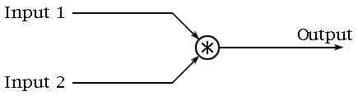
Ring modulation
Audio-frequency amplitude modulation
Multiply signal by a sinusoid
Resulting frequencies will differ from input
Sum and difference frequencies
Known as sidebands
Output not harmonic
Sounds can be quite dissonant, even for simple inputs
Not widely used for this reason
Notes:
A ring modulator is a simple device that can be used to create unusual sounds from an instrument’s output. It takes two signals (each with some frequency), and produces a signal containing the sum and differences of those frequencies. These frequencies will typically be non-harmonic, so the ring modulator can create some very dissonant sounds. For this reason, ring modulation is not a widely used effect.
Sound Set 1: A phrase played on guitar, and then the same phrase played through a ring modulator (mixed together with the guitar's output).

Slide 27
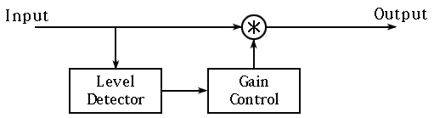
Compression
Compressor = amplifier with variable gain control
Gain always ≤ 1
Crucially: gain controlled by level of input
High signal level gain ≪ 1
Low signal level gain ≈ 1
Two ways to calculate signal level
Before or after compression is applied
“Feedforward” and “feedback” strategies
We have mostly seen feedforward version
Notes:
A compressor is basically a variable gain device, where the amount of gain used depends on the level of the input. In this case, the gain will be reduced when the signal level is high which makes louder passages softer, reducing the dynamic range. The basic scheme is shown.

Slide 28
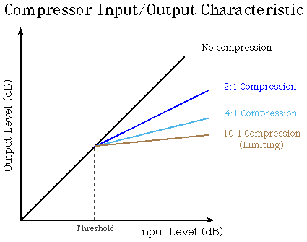
Compression terminology
Knee = transition between
compressed and
uncompressed
regions
Threshold = input level at which
compressor activates
(below this, gain = 1)
Ratio = amount that increasing
input level affects output level
(not the same as gain -- why?)
Notes:
The compressor setting is usually stated as a ratio, such as 2:1, which means that the input level would have to increase by two decibels to create a one decibel increase in the output. With a 4:1 setting, the input would need to change by 4 dB for a 1 dB change in the output level, and so on. Limiting is simply an extreme form of compression where the input/output relationship become very flat (10:1 or higher). This places a hard limit on the signal level.
So looking at previous figure, we can see that the compressor makes loud signals quieter, but it does not make quiet sounds louder (although it may be perceived that way).

Slide 29
Attack and release time
Attack time and release time are properties of the level detector (not the gain control)
Assume level detector operates over a time window
Attack time = how long it takes to respond when input rises above the threshold
Usually short, less than 100ms
Release time = how long it takes to respond when input falls below the threshold
Usually larger than attack time, e.g. 1-2 seconds
Also know:
Limiting, ducking, look-ahead, de-essing, etc.
Difference between compression and distortion
Pumping and breathing (and how to deal with them)

Slide 30
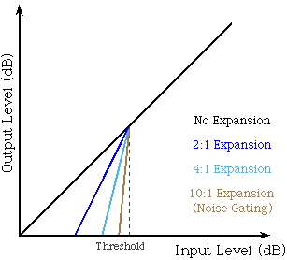
Expansion
Knee = transition between
expanded and
unexpanded
regions
Threshold = input level at which
expander activates
(above this, gain = 1)
Ratio = amount that decreasing
input level affects output level
(not the same as gain)
Also know: noise gating

Slide 31
Reverb, echo and delay
Reverb is not just a series of echoes
Echo: distinct, delayed version of sound
Delay more than 0.1-0.2 seconds
Reverb: many closely-spaced copies of a sound
Do not perceive reflections as echoes
However, the overall effect is highly audible
Delay with feedback does not produce reverb
Delay: reflections with fixed time interval
Reverb: rate of arriving reflections changes over time
Greater spacing of initial reflections, closer spacing later
Notes:
It's very tempting to say that reverb is a series of echoes, but this isn't quite correct. 'Echo' generally implies a distinct, delayed version of a sound, as you would hear with a delay more than one or two-tenths of a second. With reverb, each delayed sound wave arrives in such a short period of time that we do not perceive each reflection as a copy of the original sound. Even though we can't discern every reflection, we still hear the effect that the entire series of reflections has.
So far, it sounds like a simple delay device with feedback might produce reverberation. Although a delay can add a similar effect, there is one very important feature that a simple delay unit will not produce - the rate of arriving reflections changes over time, whereas the delay can only simulate reflections with a fixed time interval between them.

Slide 32
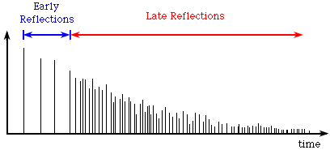
Reverb impulse response
Series of scaled delta functions
Each line represents a delayed, attenuated copy of sound
What would a simple feedback delay look like?
Notes:
An example impulse response for a room is depicted in Figure. (For those who are not sure what an impulse response is, think of it like this. If you consider a small piece of a sound, each vertical line marks when that same piece of sound is heard again, and the height of the columns is how loud the sound is at that time.)

Slide 33
Phase vocoder
Frequency-domain processing
Based on periodic windows processed by DFT/IDFT
Overlap-Add processing method:
Take m^{th} segment (frame) of length M using windowing function
Take DFT of length N ≥ M of segment
If N > M, zero-pad the segment (add zeros to end)
Do something interesting to frequency data
Take IDFT to get back to time domain segment
Add the result to the output buffer containing the prior segments
Advance by the hop size to (m+1)^{th} frame and repeat
Also know:
Robotisation, whisperisation, mutation, denoising, pitch-shift or time-stretch (basics only)
Latency considerations

Slide 34
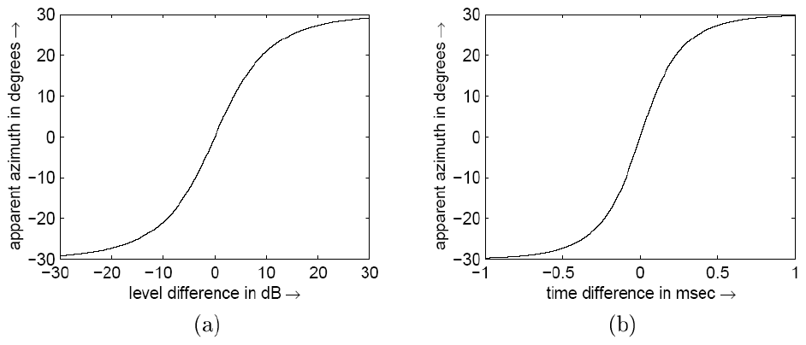
Spatial audio: gain and delay
Two primary tools for placing sounds in space
Interaural Level Difference and Interaural Time Difference
> 1ms or > 30dB: sound localised to one source
Also know: HRTF (basic concept, not equations)
Two simultaneous sounds
with level difference
Two equal amplitude sounds
with time difference

